Slide 1
Week 7 - The Different Interpretations of Spatial Relationship
LT3234 Language and Cognition
Alan SIN Man Long (54339418)
Gigi WONG Man Chi (5403 3000)
Kenix TAI Wing Lam (54915198)
Mia WAN Yuwei(5438 2027)
Muriel LEUNG Sin Yee (5479 7429)

Slide 2
1.
Introduction

Slide 3
Agenda
Introduction
2.
“Space” in Cognitive Linguistics
3.
Simple Notion (Q.8)
4.
Complex Notion (Q.7)
5.
Conclusion
Notes:
DIfferent interpretations of spatial relationship → Simple Notion: Question 8
There’s a more complex notion of spatial relationship → Complex Notion: Question 7
What are the differences of the two sentences?
Under what situations are the two sentences applied?
What do bolded words mean?
What is the relationship of bolded words to static verbs (is, are) in the sentences?

Slide 4
2.
“Space” in Cognitive Linguistics

Slide 5
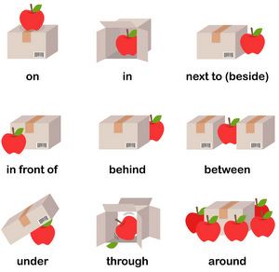
Understanding of objects and the way they relate to each other in physical space
Notes:
use words like up/down/in/at/on/off to construct mental models of the external world

Slide 6
External world transformed into a major part of the grammatical system

Slide 7
Spatial relationships are fundamental in two ways:
Physical
A person/object/place’s location in relation to others
2. Metaphorical
Using space to structure the abstract aspects of human experience

Slide 8
3.
Simple Notion (Q.8)

Slide 9
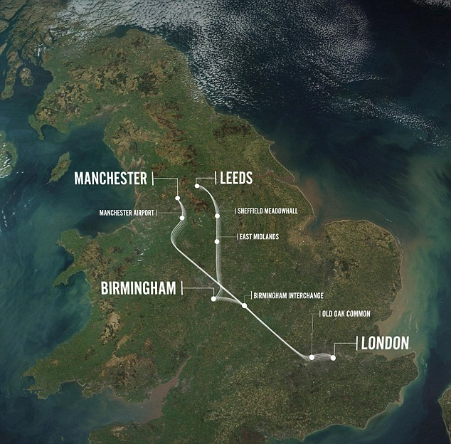
Q.8 Travelling from Manchester to London
Going down to London
Going up to London

Slide 10
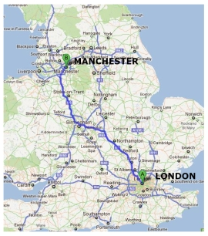
Going down to London
Foregrounds london as a geographical location
London is to the south of Manchester, hence, “going down to London”
Physical spatial relationship

Slide 11
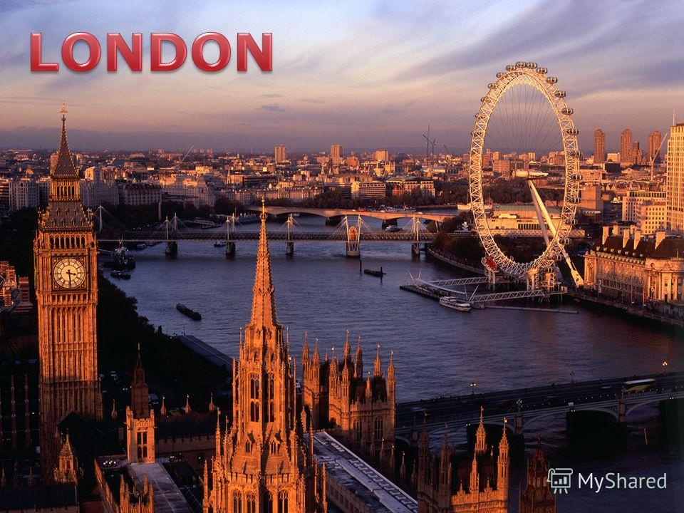
(b) Going up to London
Foregrounds london as a capital
London is superior to Manchester in terms of city status, hence, “going up to London”
Metaphorical spatial relationship
Notes:
“Going up to London” is also comprehensible because when we look at London as the capital city of London, then, it is much more superior to other cities in the country, including Manchester. So when we travel from Manchester to London, we say that we’re going up to London, as in we’re also going up the social status in terms of where different cities in England stand.

Slide 12
4.
Complex Notion (Q.7)

Slide 13
There are farms every so often through the valley.
Space-Time relation
every so often is an expression of time
“not very often”
describing spatial density with the concept of time
“only a few farms are distributed throughout the valley
from the perspective of a traveler travelling through the valley

Slide 14
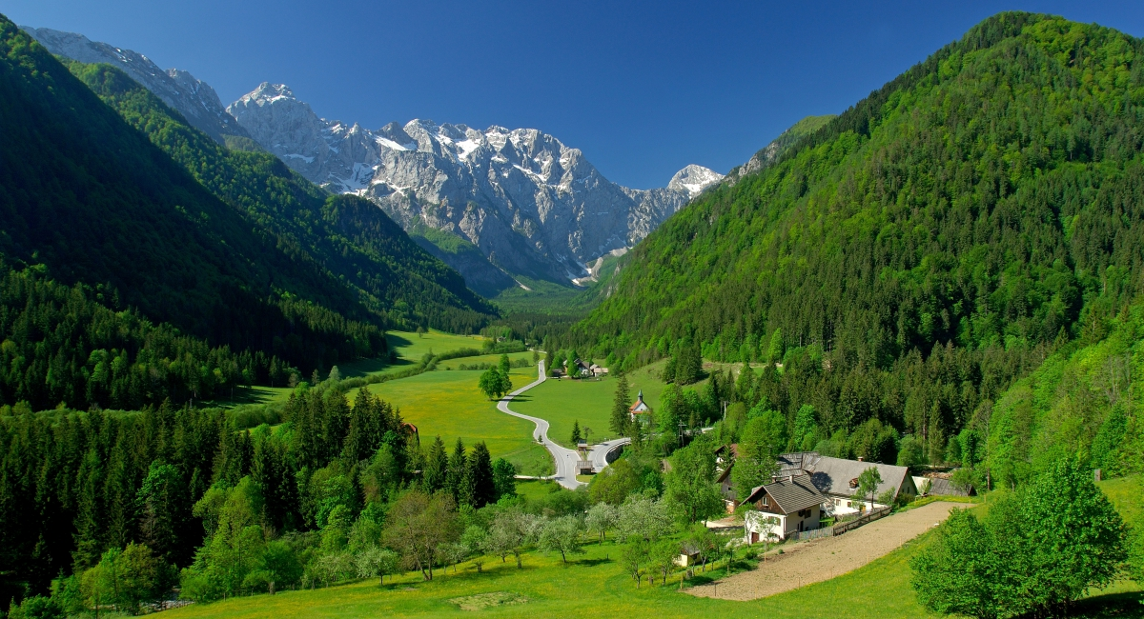
The traveler’s path is also a continuous timeline.
On this timeline, every so often, there appears a farm.

Slide 15
Space-Time
Space and time are closely related.
They are both construed as continuum.

Slide 16
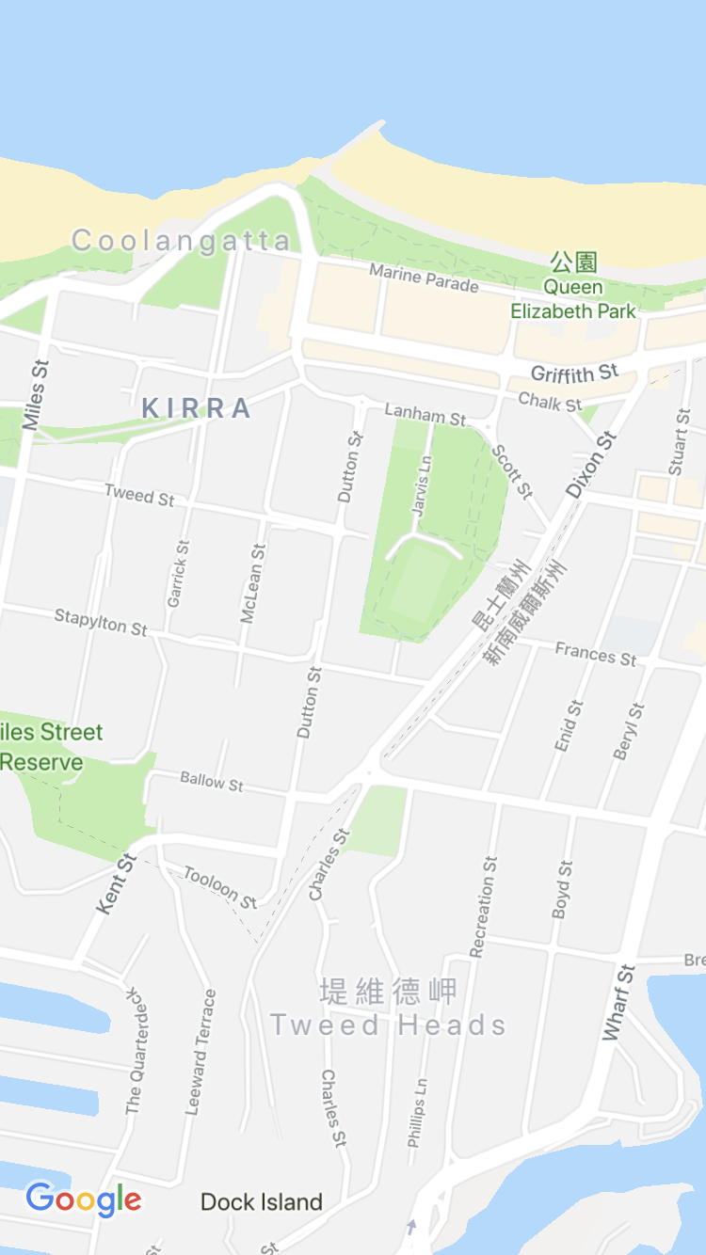
(b) Coolangatta is still in Queensland but Tweed Heads is already in New South Wales
Making comparison with two neighboring place and highlighting by bold expressions to emphasize the border between Queensland and New South Wales.

Slide 17
Verb ‘be’ together with highlighted word
There are farms every so often…Coolangatta is still…
Tweed Heads is already...

Slide 18
Every so often
Every:
Used to show that something is repeated regularly
Often:
Many times
Repeat:
to happen, or to do something again/more than once
＊When something is “repeated”, it means that there is something which have been done/ended already, and that thing is happened again.
→ There are changes between something ended and happened again.
Dynamic
OED: from time to time, at intervals.
At intervals:
Repeated after a particular period of time or a particular distance

Slide 19
Still
Continuing to happen or continuing to be done.
Staying in the same position; not moving
To make something stop moving or become more calm
A time when it is quiet and calm
Static

Slide 20
Already
Before the present time
Earlier than the time expected
＊ The situation are the same between the above time spot.
Static

Slide 21
5.
Conclusion

Slide 22
Comparison of Q7 and Q8
Both talk about spatial relationship in metaphorical way
They are at different levels.
itself vs. other
one time vs. points in a process
abstract vs. concrete

Slide 23
Itself vs. Other
for Q8, metaphor is caused by geographical and social factors of cities themselves without a third party.
In Q7, a third party is introduced. Though there is no actual words say so, we feel that there is another experiencer like traveller or pedestrian.

Slide 24
One time vs. Points in a process
For Q8, either ‘up’ or ‘down’ is a direct and pure movement which is usually done once.
For Q7, the metaphor uses distribution of points in a timeline to talk about spatial distribution in reality
----> more flexible and dynamic

Slide 25
Abstract vs. Concrete
In Q8, different social status result in the metaphor contained in ‘up’. However, this movement is not a part of metaphor and the metaphor itself is abstract (high-low).
In Q7, the metaphor is constructed by several points in a timeline. This movement constructs the metaphor and the metaphor itself is concrete.

Slide 26
Conclusion
The location of places are fixed and the physical way of spatial relationship maybe static.
The metaphorical ways are various and can be dynamic.
----> We need to choose proper metaphor based on situation and ideal interpretation we want.

Slide 27
THANKS!
😉
Any questions?

